Slide 1
Council Update
OCASA
June 2012

Slide 2
College Employer Council
Enacted through legislation – Colleges Collective Bargaining Act, 2008
Commenced operations – April 1, 2010
Not for profit statutory corporation
Owned and operated by the 24 Ontario Colleges
Mandate -bargaining agent
-policy holder for benefits
-recommendations on admin comp, Ts & Cs
-range of services on HR management issues

Slide 3
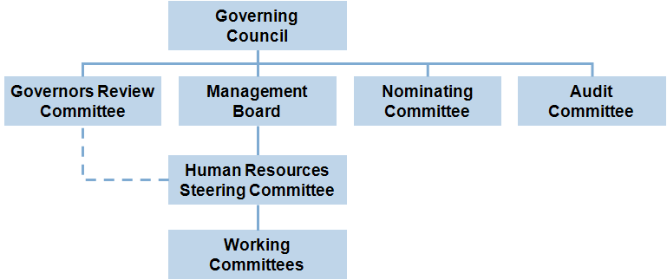
Governance

Slide 4
Human Resource Information
16,800 full time employees
2,350 administrative
46,000 non-full time
Colleges spend $2.3B annually on human resources (largest expenditure at every college)
Group insurance benefits contract = $105M annual cash flow + $150M deposit fund investments

Slide 5
2012 - 2013
Reached settlement within BPS directive
Improved bargaining communications with mircro-site
Established working group with CAAT pension plan
Formed consortium with 10 colleges on EAP provider
Additional governance training for college governors in collaboration with Colleges Ontario
3rd party claims audit at Sunlife
Received input from OCASA on job evaluation and recommendations on compensation
Introduced e-record management system for retaining corporate knowledge
Continue processing of part-time certification application at OLRB

