Slide 1
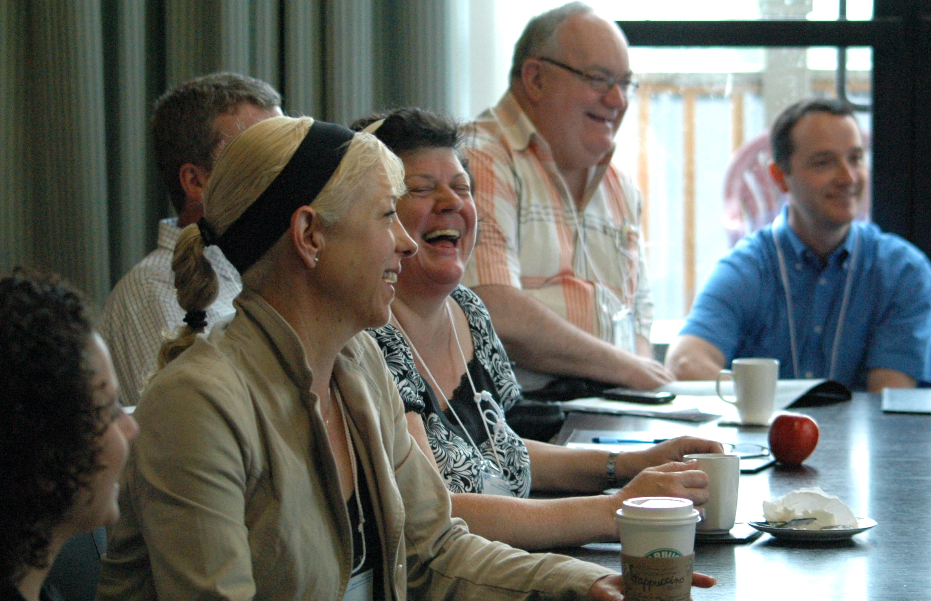
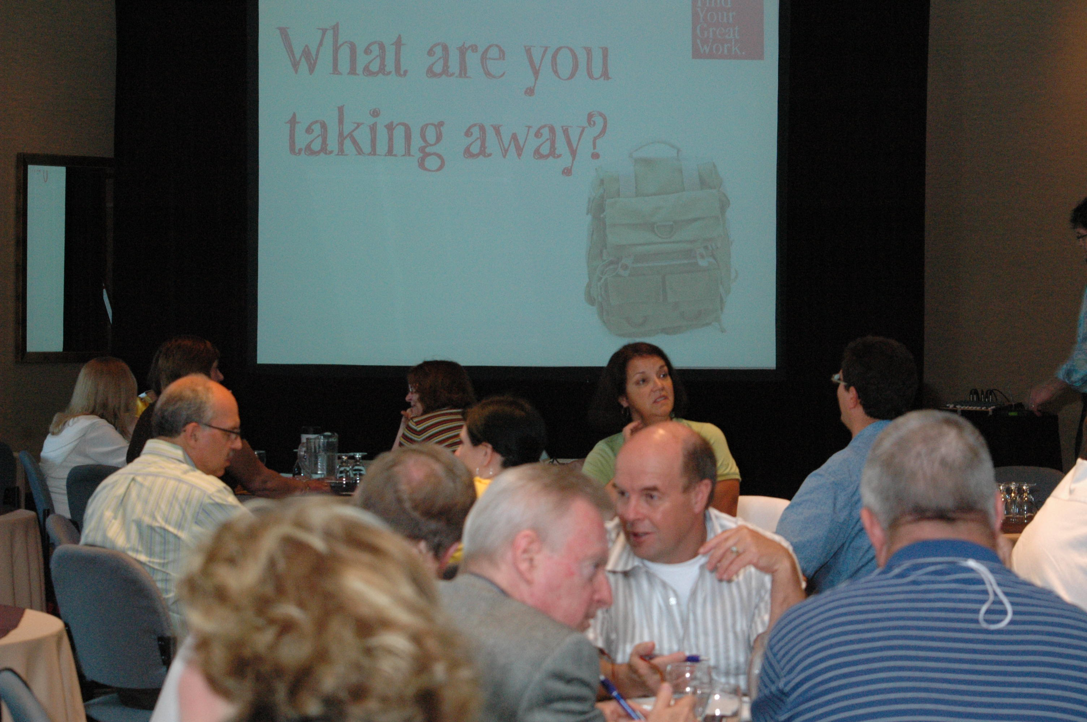
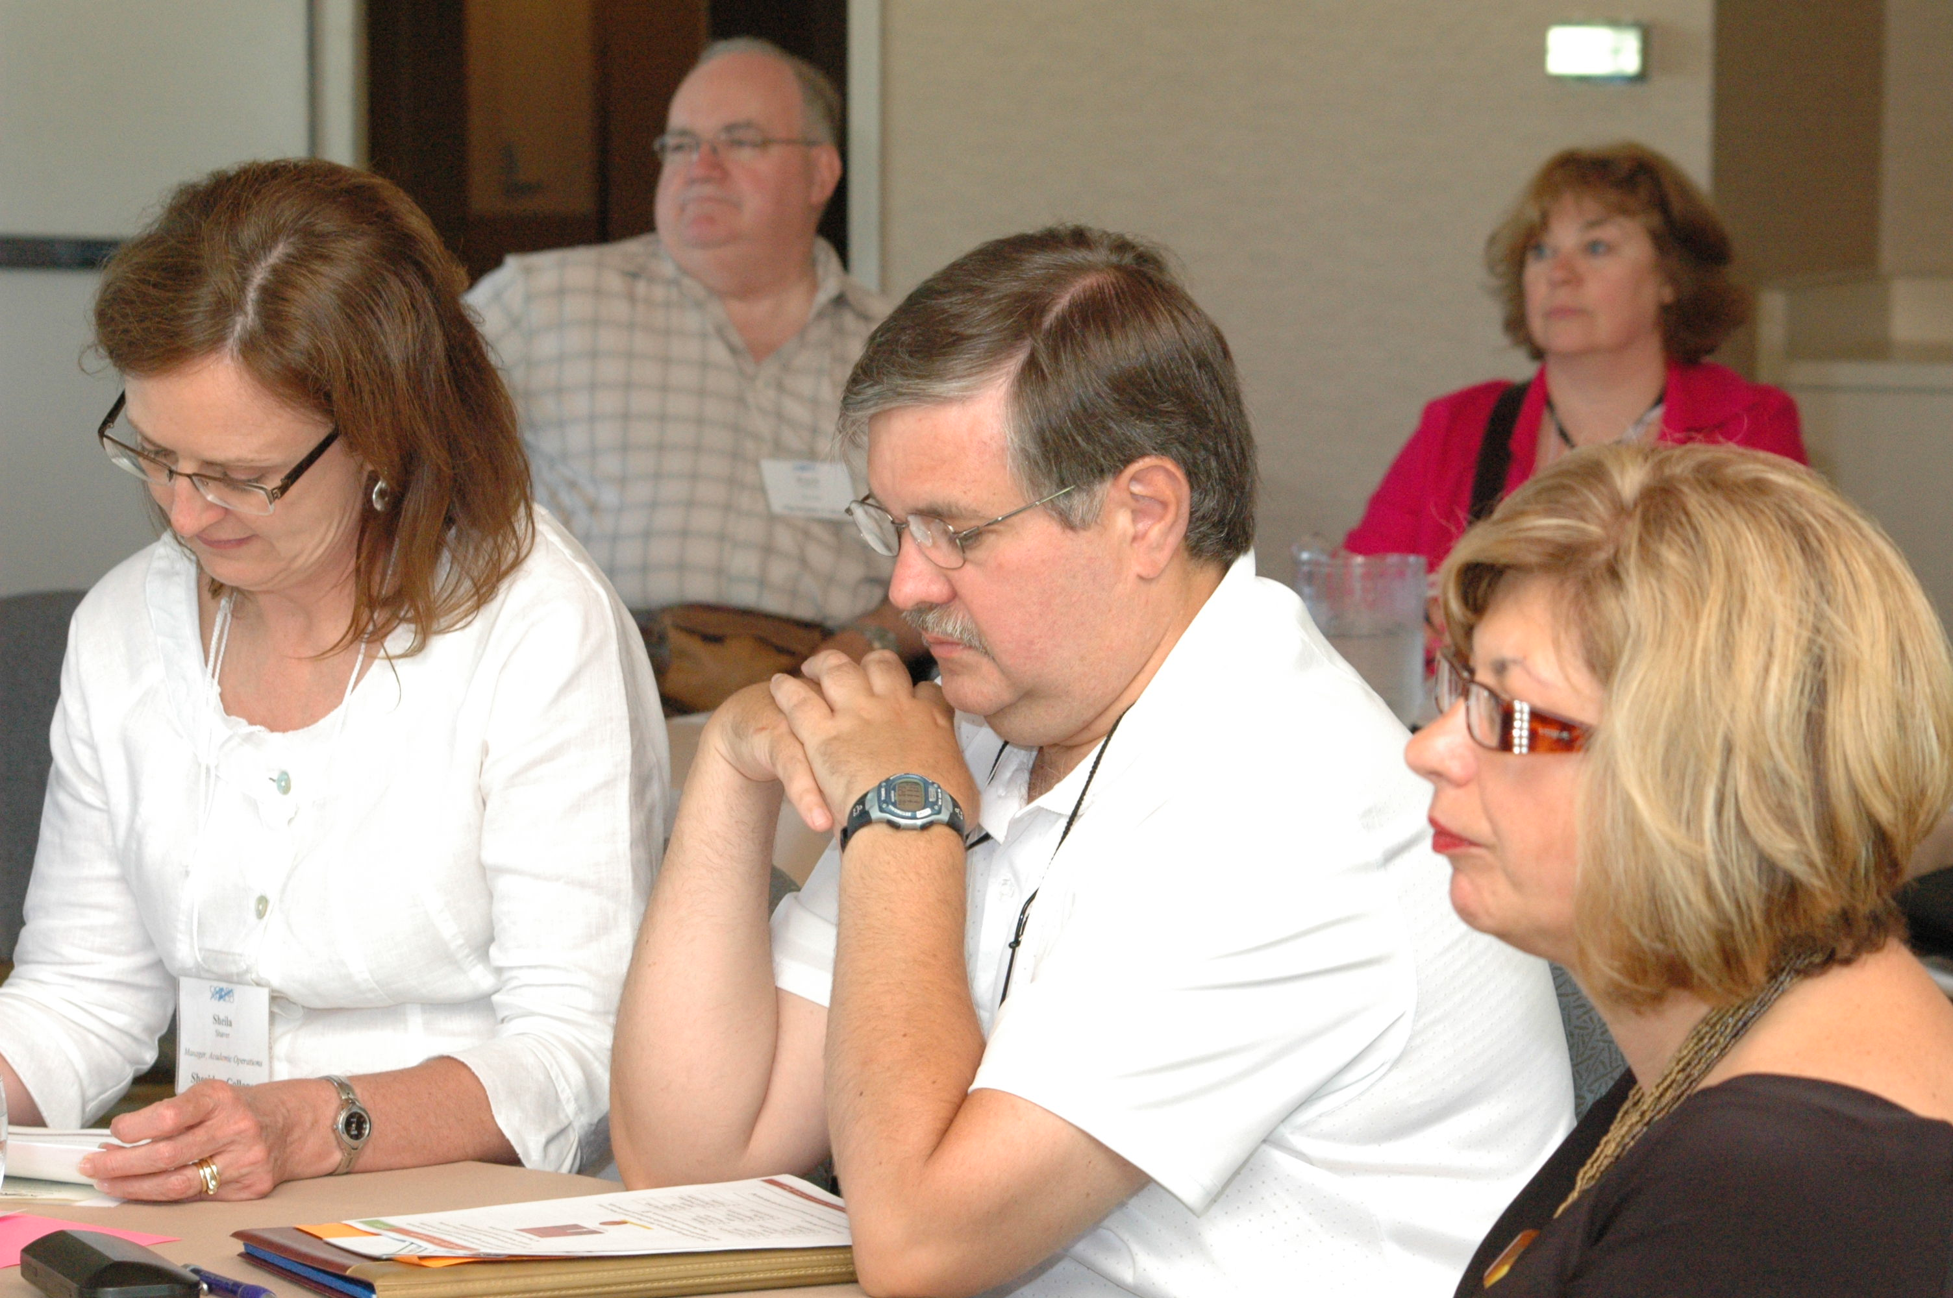
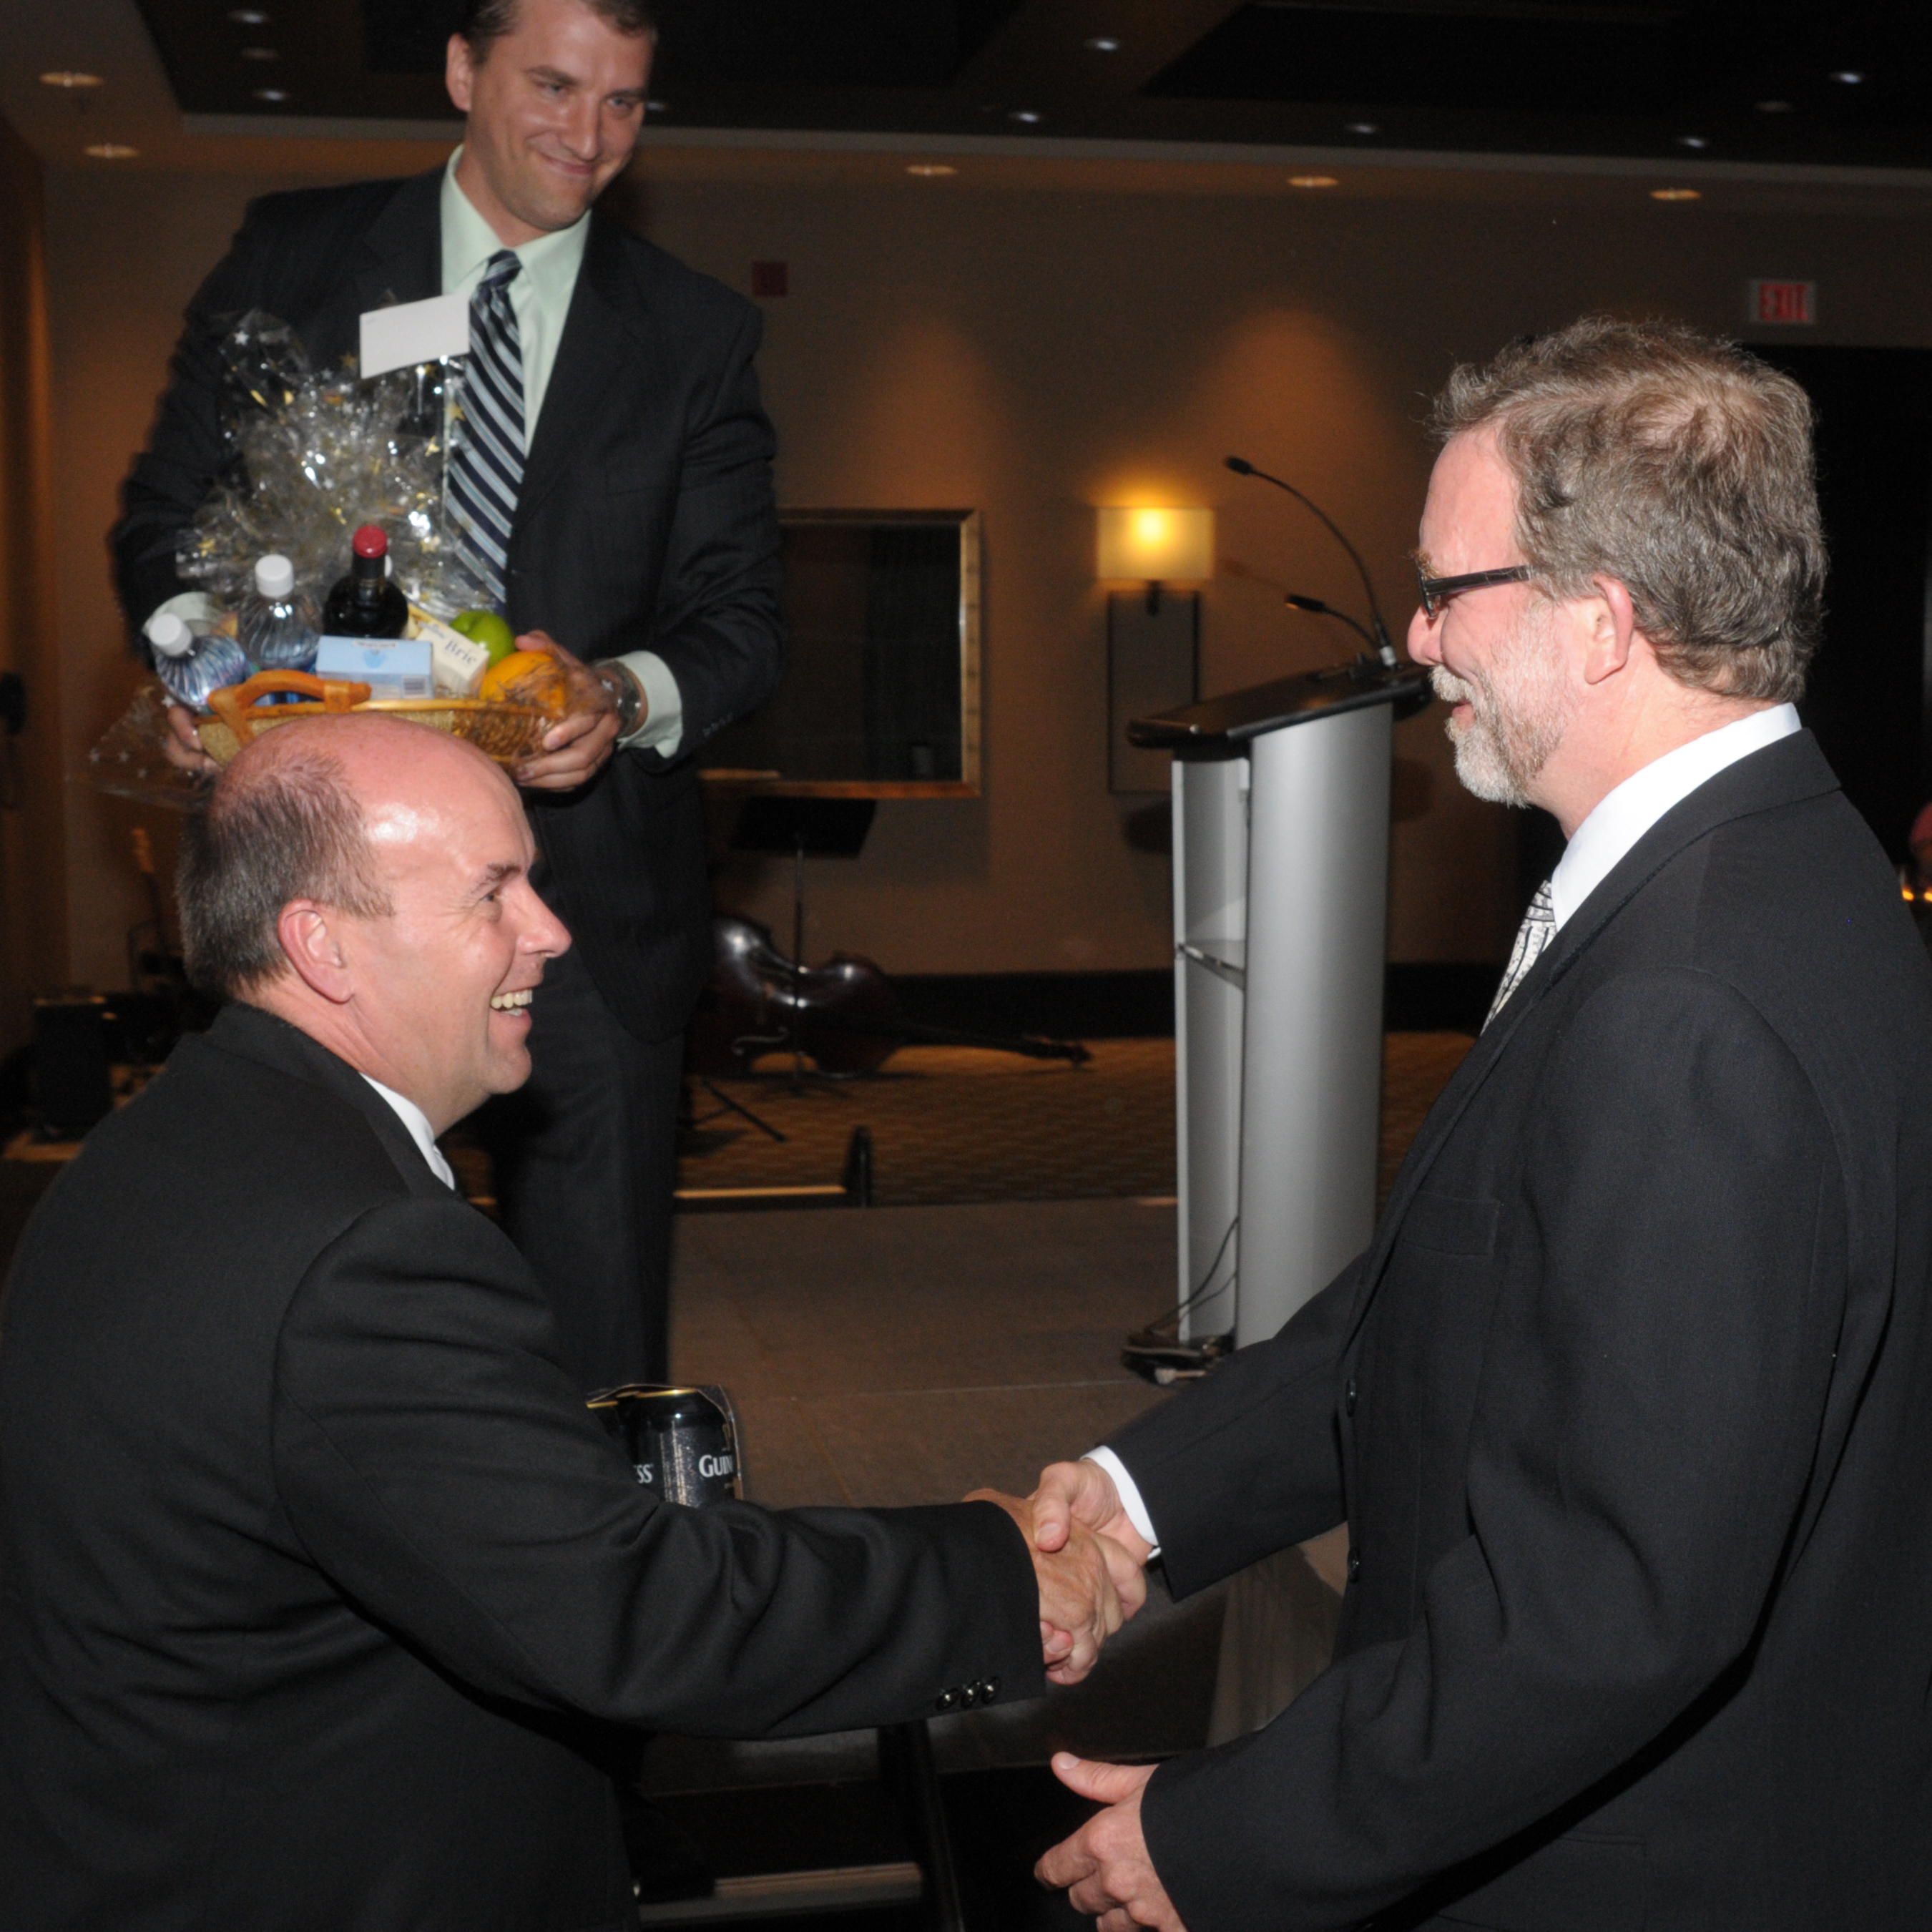
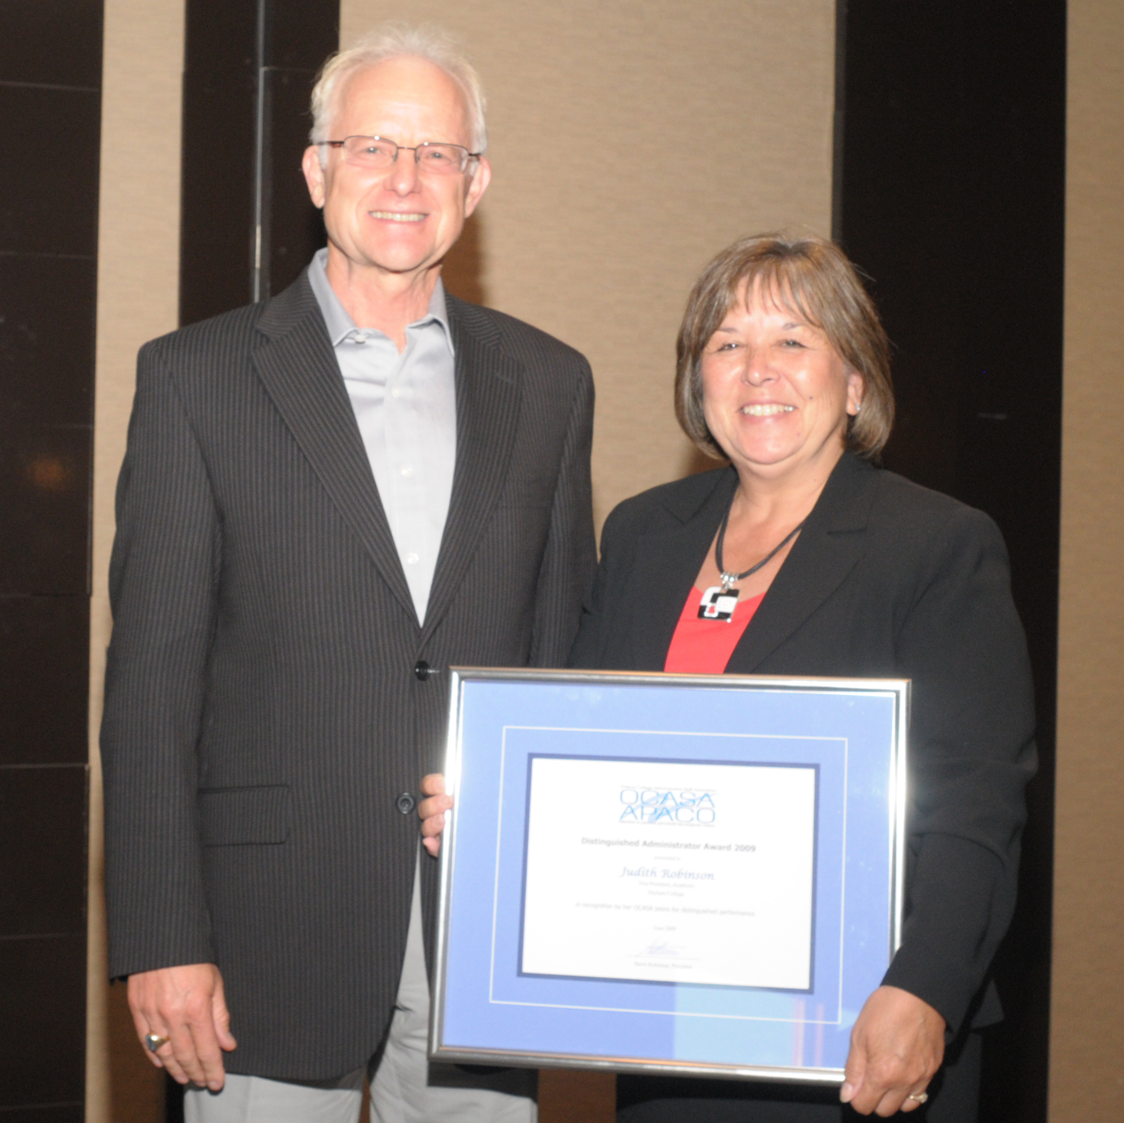
Your partner in administrative excellence.

Slide 2
Why we’re here
The “right” conversation
Embracing partnership
Consistency in membership support
Your partner in administrative excellence.
Notes:
We have provided in your meeting materials, some background information about OCASA. Hopefully you will have a chance to review it if you haven’t already. It basically outlines our strategic objectives, history and activities.
So, why we’re here today.
OCASA brings significant value to college system and after 16 years, we’re convinced there are many potential opportunities to bring even greater value to the college system, but we first need to be in the “right” conversation about what OCASA is and what role we play. That is the first item.
Secondly, we would like to encourage you as presidents, to take next steps with us in finding opportunities for partnerships moving forward.
Third, we would also like to talk about ensuring that all administrators have access to information about OCASA, and the opportunity to join. There are currently inconsistencies in membership support that partly inhibit OCASA from fully supporting the professional interests of college administrators, and colleges. This also ties in with the value of partnering with a local Administrative Staff Association (ASA)

Slide 3
Leadership Capacity Building
Network of professionals
Professional development
Critical issues discourse
Leadership
Building partnerships
Your partner in administrative excellence.
Notes:
First, just a few notes about OCASA’s commitment to supporting college administration and how we bring value to Ontario’s colleges. Notably as we look forward we all know the need for building leadership capacity. OCASA is already engaged in activities supporting that goal.
We provide a network of professionals, which is used for exchange of best practices, benchmarks, etc.
Professional development, through our annual PD conference, online education and web resources
Critical issues discourse: we want to encourage conversations about the common issues facing administrators, whether its leadership, succession planning, innovation in the face of bureaucracy or the need for mentors. These are all topics being considered in think tanks at the upcoming conference.
Leadership: opportunities to be involved as leaders in colleges, the system
And also OCASA is about building partnerships – this brings synergies necessary for capacity building.

Slide 4
OCASA’s Accomplishments
Annual PD Conference
Online Certification program
COLLEGE ADMINISTRATOR
Website support
Credible presence and relationships
Your partner in administrative excellence.
Notes:
It’s also worth noting the outcomes from our commitment to supporting college administrators.
The annual PD conference is in its 6th year. This has grown in purpose, diversity of participants, and interest. Ten presidents, 9 who are still in the system have joined us for a presidents’ panel in the past two years. This has been a highlight along with the excellent PD and networking that administrators enjoy. This event is open to all admin. This year Jesse Hirsh is our keynote speaker.
Online certification – indicated as a need by many members, early indications is that we are on the right track. Testimonials are very strong from the first two courses. This is an obvious area for partnership moving forward.
College Administrator, our semi-annual professional journal. We would welcome your ideas for articles. This is one place where we encourage discourse. This is not like a trade magazine, or where we simply give member news.
Website, now the pressure to engage social media, but we’re moving gently there.
Finally, if we had not developed trust and demonstrated credibility we likely wouldn’t be here now. We believe strongly in working with the system, building relationships and alliances that will bring benefit to administrators, and our members.

Slide 5
The “OLD” Conversation
“OCASA is like a union.”
“OCASA is not a union.”
Your partner in administrative excellence.
Notes:
OCASA has goals, dreams and a vision for opportunities that bring real value to our members as they work to fulfill the strategic goals at their respective colleges. But a significant barrier is what I’m calling, the Old conversation. OCASA is like a union, or OCASA is not a union. However stated, when OCASA is compared to a union…

Slide 6
The “OLD” Conversation
“OCASA is like a union.”
“OCASA is not a union.”
Your partner in administrative excellence.
Notes:
It boxes us in. We’re limited by how we can be received and embraced in the colleges. We would liken it to Colleges Ontario in representing all of your interests. If the conversation is only about how you are or aren’t like a university, it limits the real understanding of what colleges are accomplishing and your ability to be a major player in PSE. CO is an association, representing and advocating your interests and has very strategically and creatively redefined the public’s (and government’s) notion of what colleges are.
Similarly, we think there needs to be a new conversation about OCASA.

Slide 7
The “NEW” Conversation
“OCASA is a Professional Association.”
Your partner in administrative excellence.
Notes:
OCASA is a professional association. What do associations do?
They represent common interests, they build up their industry to make it more successful, to attract better talent, to be more successful. Once you’re in this conversation, then we can talk about …

Slide 8
The “NEW” Opportunity
“OCASA is a professional association”
Capacity Building
Achievements
Innovation
Flexibility
Responsiveness
Professional Excellence
Your partner in administrative excellence.
Notes:
When we accept this reality, then we can enter into the conversation about the new opportunities. Here is where we can engage with our members, with the college community, about ….capacity, etc.
Because that is what we are about. There is no doubt that OCASA enjoys the privilege of representing administrators interests through information gathering, and solutions based consultation but that is exactly what professional associations do – they advocate for their members, be it with industry, government or the public. And I would argue, that empowers our members, when done in a healthy, respectful environment that welcomes their input and voice.
That is not negotiating. That is not collective bargaining. That is, once again, what healthy, vibrant professional associations do. But they also have the privilege to offer other supports, like PD, networking, etc.

Slide 9
The Vision
Leadership capacity
Partner in PD
Synergies and efficiencies
Network/best practices
Professional Excellence
100% membership
“Your partner in administrative excellence.”
Your partner in administrative excellence.
Notes:
And so, in this conversation we can dream. Our vision statement to our members is Your partner in administrative excellence. I would suggest to you, this is also our vision in this conversation with you as the committee of presidents, that OCASA would be YOUR partner in administrative excellence. And here we can participate in …leadership, etc.
Our dream/ our visions sees us as not just a “stakeholder” with interests, but a dynamic partner, representing college administrators. This leads us to membership. We wish it were the norm. But given human nature, busy places, and inconsistent information flow, we still maintain our 40% province-wide.

Slide 10
Membership shows inconsistencies
System-wide we have about 40% membership
14 colleges have active ASAs
10 colleges have 50% or better membership
Very high retention rate
Your partner in administrative excellence.
Notes:
Here are a few stats:
We would also propose, that many people place OCASA in the Old conversation, and this is a barrier to OCASA membership. For OCASA to move forward, to be a vibrant partner working with you, not against, we need to be truly representative. It’s also worth noting that the discussion about conflict of interest, and “necessary” exclusions, is based on the old conversation.
We have best practices for how colleges can support membership is very meaningful and appropriate ways so that new hires, know about this group that is a sponsor of their pension plan, represents them in a variety of forums and works to provide professional support.

Slide 11
Your support for “NEW” opportunities
Commitment to the “NEW” conversation at your college
Viewing OCASA as a partner and taking next steps
Commitment to best practices supporting OCASA membership
Your partner in administrative excellence.
Notes:
Today, we ask for your support for new opportunities.
Thank you.

Slide 12
Your partner in administrative excellence.
Notes:
Thank you.

